Slide 1
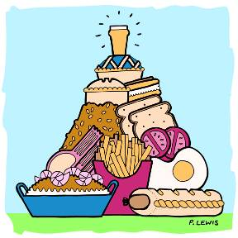
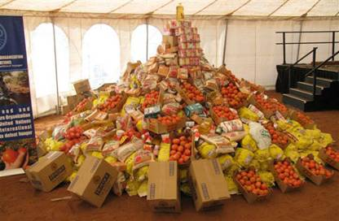
Unit 3
A day out
Welcome to the unit

Slide 2
单词回顾
学生早读时已预习过本单元单
词，可利用几分钟时间带学生快速回顾温习。对单词的熟练度越高，阅读的速率也越高。

Slide 3
Words & phrases review
come on ourselves
enjoy oneself
Australia
take care
来吧；赶快 pron. 我们自己
玩得愉快
澳大利亚
保重

Slide 4
Words review
coffee
top
president
wide
steel
ton
n. 咖啡
n. 顶部，(物体的)上面
n. 总统，国家主席
adj. ……宽的；宽广的
n. 钢
n. 吨

Slide 5
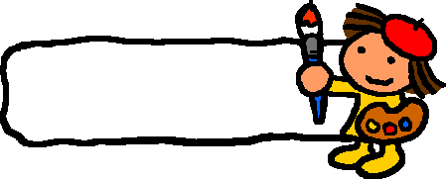
TALK
If you are free, what are you going to do? What do you think Eddie is going to do? Let’s have a look.

Slide 6
Questions
What is Eddie going to do?
He is going to exercise. He is going to climb a hill.
Is it a real hill?
No, it isn’t.

Slide 7
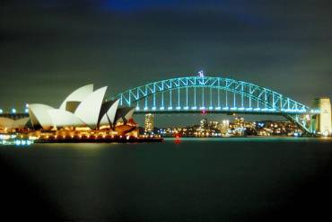
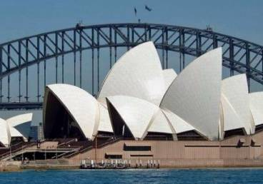
Hi Amy,
Yesterday I took a boat
trip under the famous
Habour Bridge and went past the Sydney Opera House.
I’m having a great time
in Australia!
Take care!
Nick

Slide 8
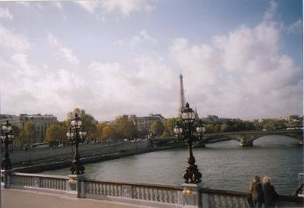
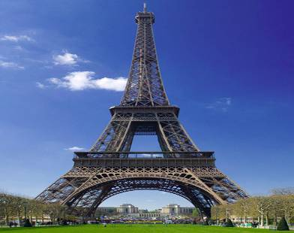
Hi Amy,
We’re sitting in a little
coffee shop by the River
Seine. We’re going to the top of the Eiffel Tower this afternoon!
All the best,
Leo

Slide 9
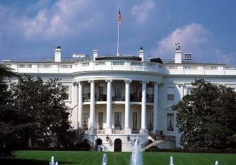
Hi Simon,
I saw the White House today. It is a beautiful building with a big garden and many trees.
The President of the USA lives there.
See you soon,
Jane
Simon
Flat 01, 6/F, Block 3
City Garden
Ninth Street
Sunshine Town
Beijing 100000
China

Slide 10
long
Amy: How _____ is the Golden Gate
Bridge?
Simon: It’s very long, about ____ miles.
Amy: How _____ is the bridge?
Simon: It’s ____ feet wide.
Amy: The bridge is _____ of steel, isn’t
it?
Simon: Yes, and it weighs over 100,000
____.
1.7
wide
90
made
tons

Slide 11
Preview
1. To read the new words on Pages
126-127
2. To read the text on Page 32 and
try to get a general idea

Slide 12
Homework
Fill in the following sentences.
1. 你需要锻炼来保持体形。
You ____ ___ exercise to _____ ____.
2. 让我们玩得开心点吧！
Let’s ______ _________!
need
to
keep fit
enjoy
ourselves

